Slide 1

Workbook
© 2020 The PiXL Club Ltd and Hachette UK
This resource may be shared with any primary school Year 6 student in its current form, and parts thereof, to enhance your transition work with students. All opinions and contributions are those of the authors. The contents of this resource are not connected with, or endorsed by, any other company, organisation or institution.
If there are any inadvertent omissions or errors in the acknowledgements or usage, this is unintended and we will remedy these on written notification.
Hachette UK own 'You Are Awesome' by Matthew Syed and 'Go Big' by Matthew Burton, which may be purchased by individuals and schools, should they wish to do so to enhance these resources for students. 'You Are Awesome' illustrations copyright © Toby Triumph. 'Go Big' illustrations copyright © Chris Madden.

Slide 2
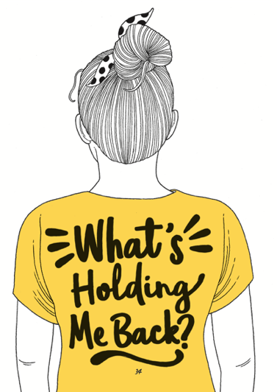
Session 1
Being awesome
TASK: Is there anything holding you back?
Worried you can’t do things
Feeling embarrassed
You find it hard to focus
Scared of hard work
Feeling stressed or anxious
Fear of looking foolish
Scared of taking risks

Slide 3
TASK: Write down what you can learn from your primary school experience ahead of going to secondary school.
How did you handle things when they went wrong?
How did you react when you got stuck?
Think about a time when you showed a ‘kid awesome’ attitude. Write about it here:
Write down the kind of person you want to be at secondary school.

Slide 4
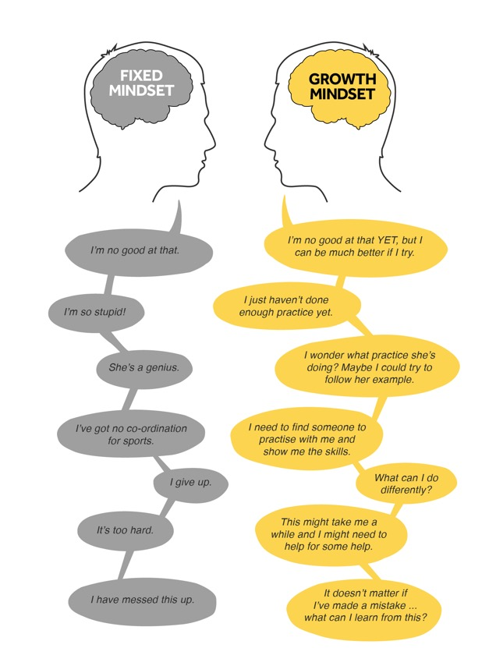
Session 2
Unlocking your mind
TASK:
Look at these two people, each with a different mindset.
Which mindset are you and why?
Does it change depending on different situations in your life?
Are you someone who thinks that you are just born intelligent?

Slide 5
The Worry Jar
What are the things you tend to worry about which might stop you from trying something new or hard?
Write them down on strips of paper (or you can write them down in your booklet).
Put those strips of paper in a worry jar – any jam jar or a pot will do.
In a week’s time, look at the strips of paper again (maybe with a parent or sibling) and see if the worries still apply.
Throw away the ones that don’t.
Take a look at the ones that are still worrying you. Is there someone you can talk to about these?

Slide 6

Use this time before Year 7 to have a go at things.
TASK:
Identify three things that you say you ‘can’t do’. Write them down.
1.
2.
3.
Now write each thing down using a growth mindset approach. For example, ‘I can’t do maths’ turns into, ‘I am going to practise the things in maths that I can’t do yet’.
1.
2.
3.
Think of something you’ve always wanted to get better at. Write it down. How could you practise that thing now?

Slide 7
Session 3
Dare to take risks
What are your hopes and dreams for secondary school?
You will be there from when you’re 11 to maybe 16 or 18 years old.
A lot will change in that time.
Write down your thoughts about the following:
What do you hope you will achieve?
What kind of person do you hope you will become?
Write down three words that you hope people will say about you.
1.
2.
3.

Slide 8
Are you scared of failure?
Everyone will be scared of failure at some point in our lives, BUT sometimes fear stops us from doing things.
It can stop you from achieving your goals and dreams.
What are you worried about ‘failing’ in secondary school?
Some Year 6 students say that they are worried about some of the following:
not making friends
not being able to do the work
that they won’t know where to go.

Slide 9
Think again about failure.
That is how we learn.
It is how we become determined.
Think of something that didn’t go quite as you had expected. What did it teach you?
Jot that down now.

Slide 10
Session 4
Making the change
Before you make a change, it is good to look back as well as look forward. Doing this can help you to see how far you have come! You started primary school when you were just 5 years old – you couldn’t read or write back then!
School memories
Name three things that have changed the most about you since you started primary school.
1.
2.
3.
What will you miss most about your old school?
What are you most concerned about in your new school?

Slide 11
New school
Write down three things that you are really excited about doing in secondary school.
Write down three worries you have about secondary school. Speak to someone you trust about your worries to help you feel better.

Slide 12
Life is a journey…
Build on who are and what you have done in primary school…
Use it as a stepping stone to help you achieve, and enjoy a new school and environment.
What are the things that you have already done at primary school that you would like to build on?
It is YOR journey…

Slide 13
Session 5
Lost but not lost
Remember when Matthew Syed talked about a ‘growth mindset’? Now is the time to remind yourself of that!
Change the statements on the left so that they are positive and hopeful. Your brain sometimes tells you negative things that are not based on fact. Your job is to tell your brain that there is another way to think and that it is wrong sometimes!
Statement | Transform it!
I won’t ever fit in. | This is not true – I will find people who are like me; I just need to find them!
I will always be lost.
I can’t do these subjects.
I won’t make friends like I had in Year 6.
I miss my primary school.
One of your own:

Slide 14
This is the Triangle of Trust
Write down who is in your Triangle of Trust.
Put their names on the triangle.
Who can you talk to about different things?
What three things makes you feel happy and good?
1.
2.
3.
Where is your safe place
to just relax?
Mr Burton’s Triangle of Trust:
YOU!!
Home/Parents
School/Teachers

Slide 15
Session 6
‘Bouncebackability’
How do you handle bouncing back?
Answer the following questions/finish the sentences:
I have shown ‘grit’ when…
2. I need to show more determination when…
3. How do you handle making a mistake?
What is your reaction?
4. Think of a time when you made a mistake.
Were you kind to yourself?

Slide 16

What does ‘work hard’ and ‘be kind’ mean?
Fill in the person outline with all the things that you can do to show you are working hard.
Now think about what you can do to be kind.
How many of these things do you do already?
Highlight the ones that you would like to do more of!

Slide 17
Session 7
What is normal anyway?
What is the uniform you will have at your new school? Do some research, go onto the school website and have a look at what they say.
Write down a list of things that you have to wear.
2. What are you NOT allowed to wear?
3. Your equipment is also part of your uniform. What do you have to take with you?

Slide 18
Find out who you are and do it deliberately.
Write down all of the ways in which you are different and unique.
How may these help you in your new school or in life?

Slide 19
Session 8
Friendships and fallouts
What kind of friends do you want to have in secondary school? Make a list.
What kind of friend do you want to be to other people? Make a list.

Slide 20
Your friendships
Who makes you laugh?
Who is a good listener?
Who can you trust?
Who will give you an honest opinion?
Who will help you get through the transition to
secondary school?

Slide 21
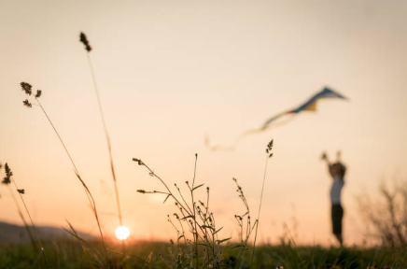
Session 9
Living well
Keeping yourself well
Write down three things that you are going to do when starting your new school to help you stay well.
1.
2.
3.

Slide 22
Here are some activities that will help you get ready for secondary school. Why don’t you try some of them?

Slide 23
Why don’t you write to your new tutor at secondary school and introduce yourself?
Tell them what you have learned from doing the ‘Be Awesome Go Big’ sessions.
You could also enter our competition - visit www.beawesomegobig.co.uk.

